Slide 1
SOFTENING

Slide 2
SOFTENING
All native fibers are associated with some oily, fatty, or waxy substance in the raw state, and its function appears to be mainly protective; the fibers are lubricated by the fatty product which is usually water repellent also.
With the exception of silk, fibers become harsher when the fatty matter is removed from wool before spinning.
Softness is very frequently required in textile materials which have been deprived of their natural fat or wax during the process of bleaching, dyeing, or printing. Certain coloring matters impart dryness and unpleasant handle to them which must be corrected before their satisfactory uses.
Softeners may be applied as finish in themselves to impart softness, smoothness, fullness, suppleness, and flexibility, all of which affect draping properties, or as a method of modifying other finishing materials.

Slide 3
DESIRABLE PROPERTIES OF TEXTILE SOFTENERS
Easy handling
Good compatibility to chemicals, easy to combine
Stable to high temperatures, not volatile by water vapour.
No yellowing
No effect on fastnesses.
No colour shade change
Low foaming, stable to shearing, no deposits on rollers
cont…..

Slide 4
Cont….
Sprayable
Non toxic, non caustic, non corrosive
Easily biodegradable
Harmless
No restriction for transportation and storing
Regular and complete bath exhaust

Slide 5
METHODS OF SOFTENING
There are two methods of softening of textile materials.
One is mechanical method by which the rigidity of the material is broken down by working it mechanically.
Another is chemical methods using softeners.

Slide 6
MECHANICAL METHODS FOR SOFTENING
Softening by mechanical methods is generally cheapest. The various methods are:
By Breaking Machine
By Calendering
By Decatising
By Raising

Slide 7
(i) BY BREAKING MACHINE
When a fabric is dried under tension ,the firmness produced thereby can be removed by running it through a machine which can distort sufficientily ; this machine is called SPIRAL SCROLL ROLLER BREAKING MACHINE.
Fabrics with a stiff handle are passed over and under the rapidly rotating scroll rollers and thereby softened.

Slide 8
(ii) CALENDERING
It is the process, where fabric is compressed by passing it between two or more rollers under controlled conditions of time, temperature, pressure whereby the fabric is softened due to bending under pressure. This treatment breaks down fiber rigidity.
Mechanical softening brought about by calendaring is temporary.

Slide 9
(iii) BY DECATISING
This is very effective mechanical softening method treatment. This method is generally given to woolen fabrics but it can be used to improve soft handle of all kinds of textile fabrics – cotton , wool, silk and rayon.
The fabric is wound on a perforated metal roller and steam is blown through the inside of the central roller and its perforations so that it passes outward from the fabric. After 1 or 2 minutes the steam is expelled by blowing compressed air through the fabric.
The fabric is then taken out and wound on a second perforated roller with the inside layer out and the process is repeated.
By this treatment, the fabric acquires a beautiful, soft and smooth handle.

Slide 10
(iv) BY RAISING
It is an useful method for given both woven and knitted fabrics a warm and soft handle. It produces a hairy or pile surface.
Raising machines with rollers covered with wire carding cloth are used. Both single acting and double acting raising machines are used to produce pile fabrics. The production of a pile surface can make the fabric exceptionally soft depending on the length of the pile. The soft, warm handle is permanent.

Slide 11
II. CHEMICAL METHOD USING SOFTENERS
Fabric softeners ( also called fabric conditioner) is used to prevent static clings and make fabric softer i.e. softening agents are applied to textiles to improve their hand, drape, cutting, and sewing qualities.
It is available as a liquid or as dryer sheets.
Fabric softeners work by coating the surface of the cloth fibers with a thin layer of chemicals; these chemicals have lubricant properties and are electrically conductive, thus making the fibers feel smoother and preventing buildup of static electricity.

Slide 12
REASONS FOR USING SOFTENERS
As the textile material goes under various mechanical and chemical processes that make the surface of the material harsh.
For example, removal of natural oils and waxes by scouring and bleaching.
As consumers are much more caring about the touch of textile material. This is also the reason for using softeners.

Slide 13
APPLICATIONS OF TEXTILE SOFTENERS IN PRACTICE
Here, the softening treatment is based on the surface application of oils, fats and waxes i.e. long chain fatty acids in one form or another. They can be classified into four main groups:
Anionic softeners
Cationic softeners
Non-ionic softeners
Reactive softeners

Slide 14
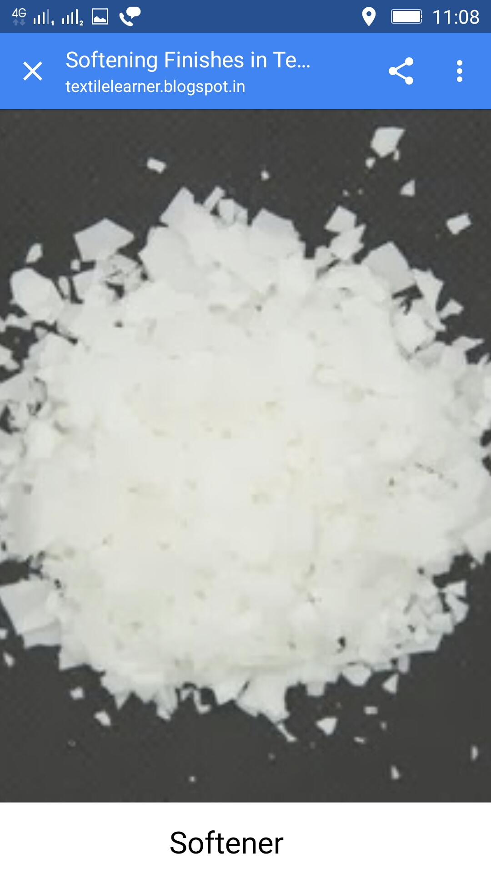

Slide 15
ANIONIC SOFTENERS
Anionic softeners are heat stable at normal textile processing temperatures and compatible with other components of dye and bleach baths. They can easily be washed off and provide strong antistatic effects and good rewetting properties because their anionic groups are oriented outward4,9 and are surrounded by a thick hydration layer.
Sulfonates are, in contrast to sulfates, resistent to hydrolysis . They are often used for special applications, such as medical textiles, or in combination with anionic fluorescent brightening agents.

Slide 16
Mechanism of the softening effect of anionic softeners

Slide 17
ADVANTAGE OF ANIONIC SOFTENER
Compatible with FBA’s
Have good rewetting properties
Do not tender Sulphur-dyed goods
Used extensively on mechanically finished fabrics e.g. brushed, sheared, sanforised.

Slide 18
DISADVANTAGE OF ANIONIC SOFTENER
Inferior in softness performance to cationics generally and sensitive to water hardness and electrolytes in the finished bath.
Usually higher concentrations required and even then cationic impart softer feel
Limited durability to laundering and dry cleaning
Not exhaust from bath (except onto wool and nylon) and must be padded

Slide 19
(ii) CATIONIC SOFTENERS
Cationic softeners have the best softness and are reasonably durable to laundering. They can be applied by exhaustion to all fibres from a high liquor to goods ratio bath and they provide a hydrophobic surface and poor rewetting properties, because their hydrophobic groups are oriented away from the fibre surface.They are usually not compatible with anionic products (precipitation of insoluble adducts).

Slide 20
Mechanism of the softening effect of cationic softener

Slide 21
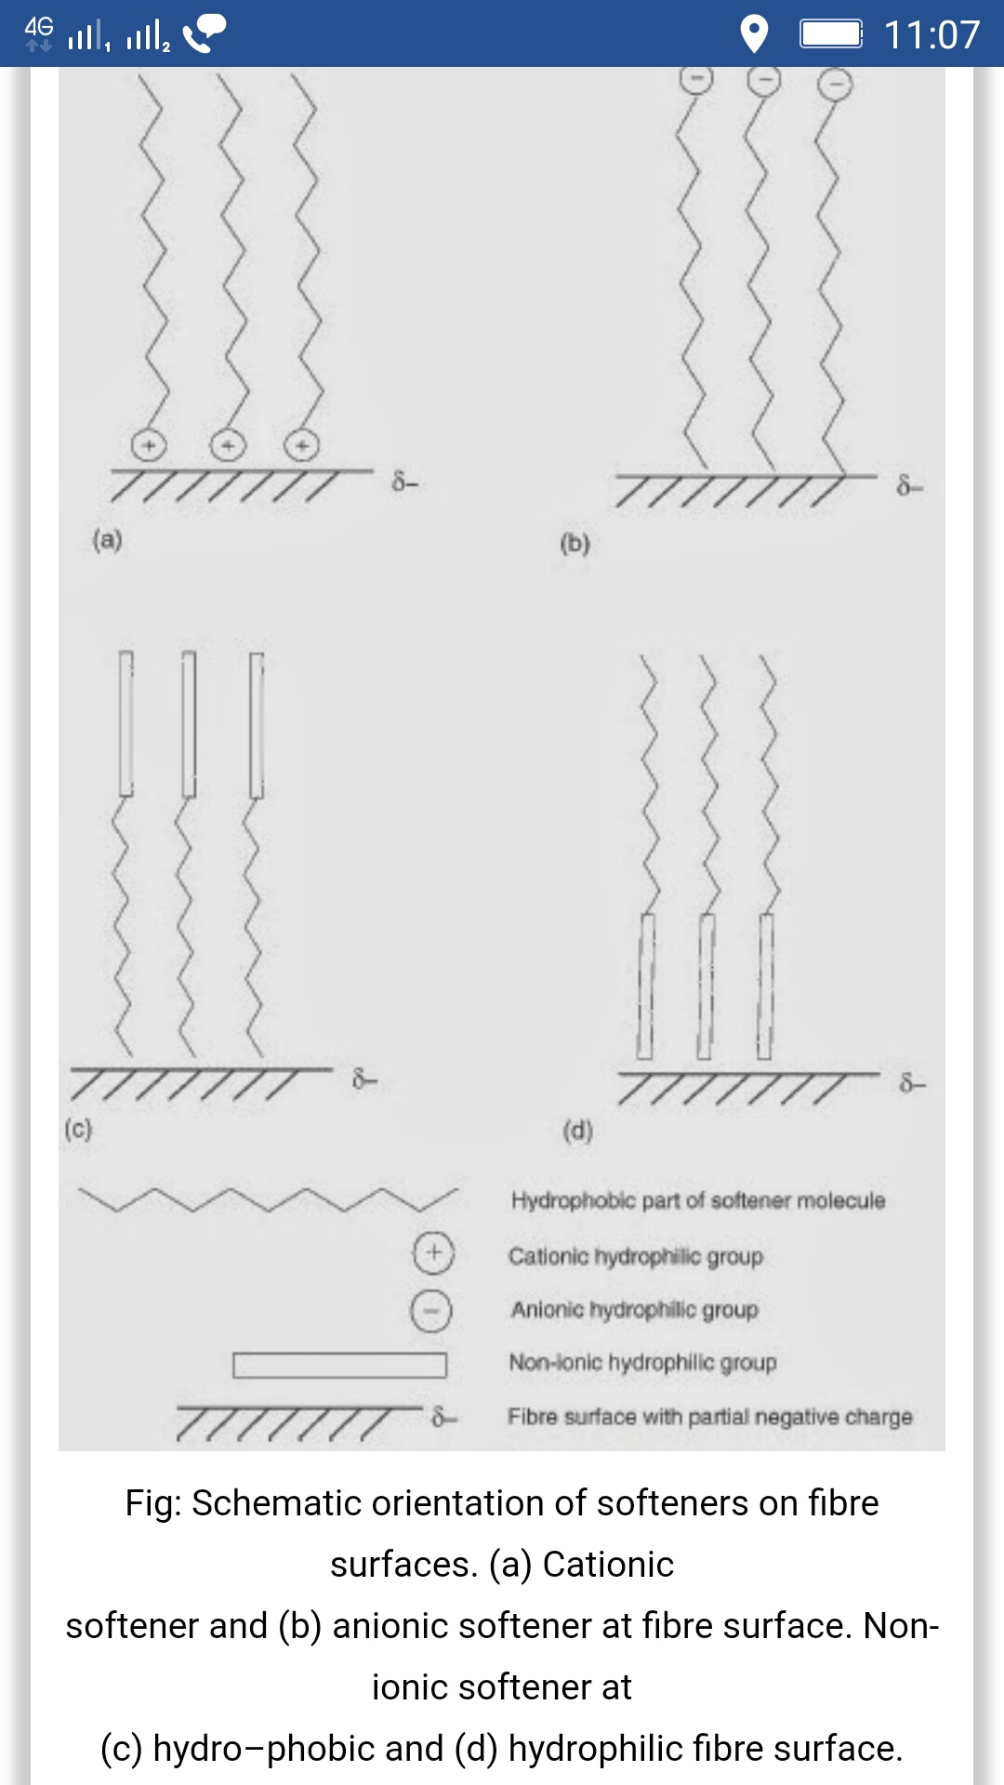

Slide 22
ADVANTAGE OF CATIONIC SOFTENERS
Soft, lofty, silky handle to most fabrics at low levels of add-on
Substantive to most fibres
Good lubricant properties and often have positive effect on wet fasteness
Improve tear strength, abrasion resistance and sewability
Improve antistatic properties (especially on synthetics).

Slide 23
DISADVANTAGE OF CATIONIC SOFTENERS
Incompatible with anionic auxiliaries including FBA’s
Free amine causes yellowing and may change dye shade or affect light fastness
May react with residual chlorine from bleach baths
Adverslyy affect soil removal properties
Can cause tendering of Sulphur dyed fabrics

Slide 24
(iii) NON IONIC SOFTENERS
They are generally condensation products of stearic and palmitic acid with ethylene oxide. Igepals are well known as non-ionic softeners.The main characterstics of non-ionics is their ‘cloud point’.
Cloud point is the temperature at which the non-ionic product becomes insoluble. At a concentration of 1% solution. They have softening and fat emulsifying properties; they do not discolour the fabrics.
They are marketed in the form of creamy pastes which can be diluted with hot water. They can be applied to the fabric by padding (10-20 g/l) and drying.

Slide 25
Non-ionic softener : Mechanism

Slide 26
ADVANTAGE OF NON-IONIC SOFTENERS
They show high lubricity ( reduced surface tension)
They are stable to extreme pH conditions and heat
Reasonable price
Compatible with most textile chemicals
Most have good non-yellowing properties and usually do not cause shade change
Compatible with cationic and anionic products including FBA’s and do not tender Sulphur-dyed goods
Easily removed if reprocessing is necessary

Slide 27
DISADVANTAGE OF NON- IONIC SOFTENER
Handle generally poorest out of anionic, cationic and non-ionic
Usually have negative effect on wet fastness properties of dyes
Cannot be easily applied and exhaust

Slide 28
(iv) REACTIVE SOFTENERS
These softeners chemically combine with textile fibres and give a permanent softening action.
They also produce water-repellent finishes. One well known reactive softener is octadecyl oxymethyl pyridinium chloride; another product is Velan PF which is stearyl amido methyl pyridinium chloride.
It is applied by padding (1-2 g/l) to any kind of fibre together with sodium acetate, squeezed, dried, cured and washed.

Slide 29
Cont….
It reacts with –OH group of cellulose and form covalent bond and gives permanent finish.
It gives a permanent soft water-repellent finish but tends to become yellow on storage.
Temperature: 90 degree Celsius Time: 4-5 minutes

Slide 30
ADVANTAGE OF REACTIVE SOFTENERS
The softening effect of reactive softener is durable
It does not cause yellowing problem
In case of resin finished fabrics, it minimizes the loss in tensile strength, tear strength and abrasion resistance
Application is easy
DISADVANTAGE: The reactive softener is comparatively costly than other softener.

Slide 31
SILICONE SOFTENERS
They provide
Very high softness
Special unique hand
High lubricity
Good sew ability
Elastic resilience , crease recovery, abrasion resistance and tear strength
They show
Good temp stability and durability
with a high degree of permanence for those products that form cross linked films and the range of properties from hydrophobic to hydrophilic.

Slide 32
SILICONE SOFTENERS
In case of cellulose, wool ,silk and polyamide fibres ,there are strong hydrogen bonds between the hydroxyl or amino groups of the fibres and the amino groups of the modified silicones.
These bonds act as an anchor for the silicone , which forms an evenly distributed film on the fibre surface.
Good water repellency and very soft handle are the result.
With an optimum content of amino side groups , the poly siloxane segments between the anchor sites are long enough to maintain their high flexibility.
This is the main reason for the softness and the lubricating effect of amino functional silicones on polar fibres.

Slide 33
IN TEXTILE FINISHING , SILICONES ARE ALSO USED AS
Water repellants
Elastomeric finishes
Coatings
defoamers

Slide 34
ADVANTAGE OF SILICONE SOFTENERS
Silky handle on all fibres
Stable to heat and light
Improve tear strength ,abrasion resistance and excellent for improving sewing properties
Amino functional silicones improve durable press performance of cotton goods
Non yellowing at moderate temperature.

Slide 35
DISADVANTAGE OF SILICON SOFTENER
Create water repellency of some type , making them unsuitable when absorbency is required
Cannot easily be removed for redyeing
expensive

Slide 36
SELECTION OF SOFTENER
YELLOWING
Usually the more cationic, the more the softener yellows.
FASTNESS PROPERTIES
Cationic softeners give better wash fastness but they may have a negative effect of light fastness.
Non- ionic may have negative effect on wet fastness.
C. SHADE CHANGE
Non ionic normally have less tendency to cause shade change
Some cationic and anionic will cause shade change.
Silicones have tendency to bloom shade

Slide 37
D. EXHAUSTIBILITY
Normally cationic softeners are recommended
Non ionic can be used with cationic emulsifiers
Anionic on wool
E. EFFECT ON SEAM SLIPPAGE
Silicones can adversely effect slippage.
F. HEAT STABILITY AND SMOKE POINT
May cause processing problem on drying
G. ODOUR
Fabric odour may be produced by the softener.

