Slide 1
Auxiliary motions of loom: Part-1 MMFT
To produce a good quality of cloth with out damages some stop motion provided on the loom
These are auxiliary motions
Required for high productivity with qualityproduct
These are useful & desirable

Slide 2
These are following kinds
Warp stop motion
Weft stops motion
Weft replenishment motion
Warp protector motion
Weft mixing motion
Feeler motion
Brake motion
Temple

Slide 3
Warp stop motion:
To stop the loom when a warp thread breaks/ excessively loose
When a drop wire fall as the result of end break
The broken end is repaired and handled by the operator
Weft replenishment motion
It ensures a continuous weft supply to loom when weft exhausted. Weft replinished
Motion provides uninterrupted picking by switching from depleted to full package.

Slide 4
Weft stop motion:
This motion able to stop the loom when a weft breaks or runs out of the pirn
In case the loom is allowed to run even after the weft breaks there will be no woven cloth except long threads of warp
Warp protector mechanism:
To protect the warp sheet by stopping the loom when shuttle trapped in path
Motion protect the warp threads by stopping the loom when the shuttle fails to reach, the selvedge side and box properly into either the shuttle box during picking

Slide 5
If shuttle fails to reach its proper box, loom must either be instantly stopped by a fast reed motion or gradually stopped by loose reed motion
It will stop the loom to prevent excessive damage to the warp threads, cloth, and reed if the weft carrier becomes trapped between the top and bottom of the shed lines and the reed

Slide 6
Brake motion:
A mechanism to stop the loom when a warp /weft yarn breaks
It is a device by means of which artificial frictional resistance is applied to moving body in order to stop the motion of a loom
The brake stops the loom immediately whenever required
The weaver uses it to stop the loom to repair broken ends / picks
Types of Brake –
•Shoe Brake
•Band Brake BRAKE

Slide 7
Temple motion:
These are used to hold fast the width of the woven cloth as equal to as possible to the width of the warp
It may be made of wood or metal
Metal is useful for rugs
TYPES OF TEMPLES
Ring Temple
Roller Temple

Slide 8
SELVEDGE
The narrow edge of woven fabric that runs parallel to the warp
It is made with stronger yarns in a tighter construction than the body of the fabric to prevent ravelling
Weft mixing motion:
This motion able to insert various coloured weft yarn into the same fabric for check and stripe effect
These are known as drop box
Circular & vertical drop are kinds
Feeler motion:
This gives indicaton whether the weft yarn in pirn is used or not
These are optical type
& mechanical type

Slide 9
Warp stop.-
Object: To stop the loom when a warp breaks/loose The operating system is the following .:-
Each warp thread is passed into the bottom slit of a metallic drop wire 2
This way is supported by the thread under tension
Top slit of the drop wire passes the contact rail 3 composed of an u-shaped outside coating in stainless steel, of a strip of insulating material and of a flat conductive inside blade in nickel-plated copper, Provided on the upper part with a toothing.
The contact rail 3 is part of a low voltage electric circuit, of which the drop wire 2 acts as circuit Breaker.

Slide 10
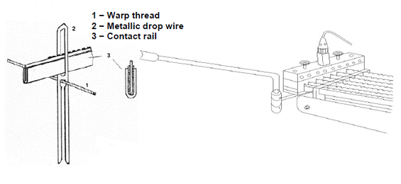
Fig-Warp stop motion

Slide 11
For details, students may go through study material which is uploaded online
In case of any query, students may ask on my contact no between 8.00-9.00 pm on my contact no: 8953911070/9415737371
“This is end of lecture-7”

