Slide 2
What is an ETP?
• ETP (Effluent Treatment Plant) is a process design for treating the industrial waste water for its reuse or safe disposal to the environment.
• Influent: Untreated industrial waste water.
• Effluent: Treated industrial waste water.
• Sludge: Solid part separated from waste water by ETP.
TREATMENT
INFLUENT
EFFLUENT
SLUDGE

Slide 3
Need of ETP
• To clean industry effluent and recycle it for further use.
• To reduce the usage of fresh/potable water in Industries.
• To cut expenditure on water procurement.
• To meet the Standards for emission or discharge of environmental pollutants from various Industries set by the Government and avoid hefty penalties.
• To safeguard environment against pollution and contribute in sustainable development.

Slide 4
Design of ETP
The design and size of the ETP depends upon:
• Quantity and quality of the industries discharge effluent.
• Land availability.
• Monetary considerations for construction, operation & maintenance. • Area dimension depends on:
➢
Quality of wastewater to be treated, Flow rate
➢
➢
Type of biological treatment to be used .
• In case of less available land, CETP (Common Effluent Treatment Plant) is preferred over ETP

Slide 5
Treatment Levels & Mechanisms of ETP • Treatment levels:
➢
Preliminary
➢
Primary
➢
Secondary
➢
Tertiary (or advanced)
• Treatment mechanisms:
➢
Physical
➢
Chemical
➢
Biological

Slide 6
Preliminary Treatment level
Purpose: Physical separation of big sized impurities like cloth, plastics, wood logs, paper, etc.
Common physical unit operations at Preliminary level are:
➢ Screening: A screen with openings of uniform size is used to remove large solids such as plastics, cloth etc. Generally maximum 10mm is used.
➢ Sedimentation: Physical water treatment process using gravity to remove suspended solids from water.
➢ Clarification: Used for separation of solids from fluids.

Slide 7
Primary Treatment Level
Purpose: Removal of floating and settleable materials such as suspended solids and organic matter.
• Methods: Both physical and chemical methods are used in this treatment level.
• Chemical unit processes:
➢ Chemical unit processes are always used with physical operations and may also be used with biological treatment processes.
➢ Chemical processes use the addition of chemicals to the wastewater to bring about changes in its quality.
➢ Example: pH control, coagulation, chemical precipitation and oxidation.

Slide 8
Primary Treatment Level (cont…) pH Control:
➢ To adjust the pH in the treatment process to make wastewater pH neutral.
➢ For alkali wastes (high pH): NaOH, Na2CO3, CaCO3or Ca(OH) ➢ For acidic wastes (low pH): H2SO4, HCl.
2.
Chemical coagulation and Flocculation:
• Coagulation refers to collecting the minute solid particles dispersed in a liquid into a larger mass.
• Chemical coagulants like Al2(SO4)3 {also called alum} or Fe2(SO4)3 are added to wastewater to improve the attraction among fine particles so that they come together and form larger particles called flocs.
• A chemical flocculent (usually a polyelectrolyte) enhances the flocculation process by bringing together particles to form larger flocs , which settle out more quickly.
• Flocculation is aided by gentle mixing which causes the particles to collide.

Slide 9
Secondary Treatment Level
Methods: Biological and chemical processes are involved in this level.
Biological unit process
To remove, or reduce the concentration of organic and inorganic compounds.
➢ Biological treatment process can take many forms but all are based around
microorganisms, mainly bacteria.
Aerobic Processes
➢ Aerobic treatment processes take place in the presence of air (oxygen).
➢ Utilizes those microorganisms (aerobes), which use molecular/free oxygen to assimilate organic impurities i.e. convert them in to carbon dioxide, water and biomass.
Anaerobic Processes
➢ The anaerobic treatment processes take place in the absence of air (oxygen).
➢ Utilizes microorganisms (anaerobes) which do not require air (molecular/free oxygen) to assimilate organic impurities.
➢ The final products are methane and biomass.

Slide 10
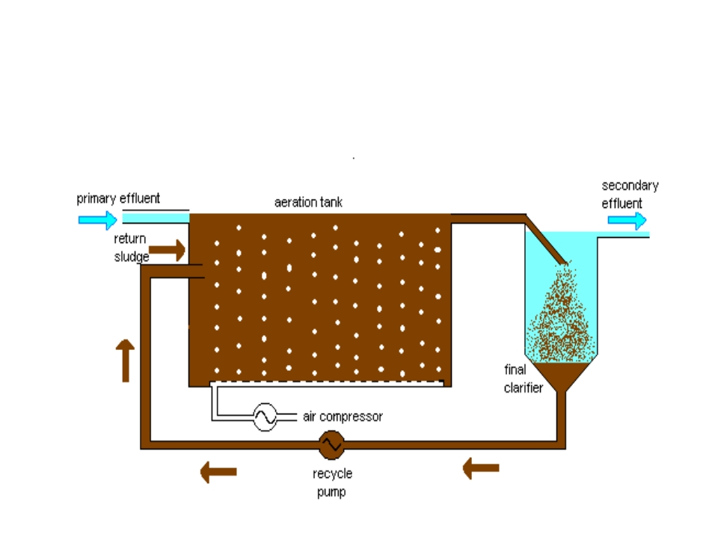
Activated sludge process

Slide 11
Tertiary / Advanced Treatment
Purpose: Final cleaning process that improves wastewater quality before it is reused, recycled or discharged to the environment.
Mechanism: Removes remaining inorganic compounds, and substances, such as the nitrogen and phosphorus. Bacteria, viruses and parasites, which are harmful to public health, are also removed at this stage.
Methods:
➢ Alum: Used to help remove additional phosphorus particles and group the remaining solids together for easy removal in the filters.
➢ Chlorine contact tank disinfects the tertiary treated wastewater by removing microorganisms in treated wastewater including bacteria, viruses and parasites.
➢ Remaining chlorine is removed by adding sodium bisulphate just before it's discharged.

Slide 12
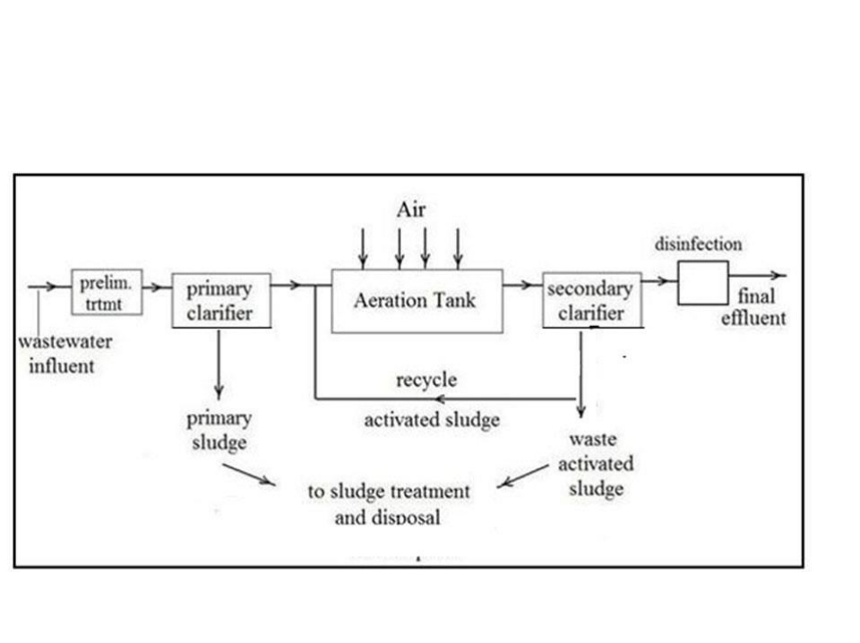
Flow chart for ETP

Slide 13
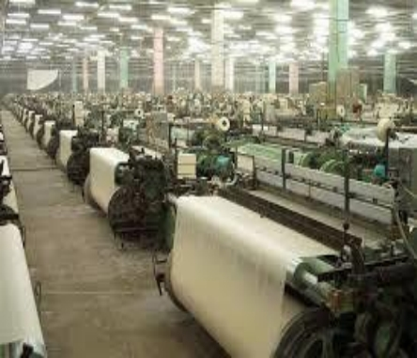
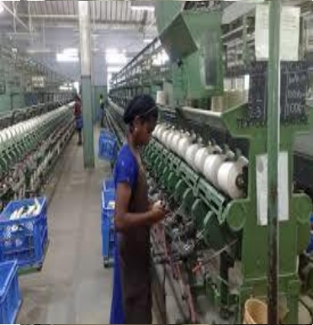
Case Study
ETP Process Design for a typical Textile factory

Slide 14
Textile Industry Share
Country | Value in ($ billion) | Share (%)
China | 94.4 | 32.1
EU27 | 76.6 | 26.1
India | 15.0 | 5.1
United States of America | 13.8 | 4.7
Korea Republic | 12.4 | 4.2
Turkey | 10.8 | 3.7
Pakistan | 9.1 | 3.1
Indonesia | 4.8 | 1.6
Vietnam | 3.8 | 1.3
Bangladesh | 1.6 | 0.5
Rest of the World | 51.7 | 17.5
Total | 294 | 99.9
Source: Ghaly A. E, Ananthashankar R., Alhattab M., and Ramakrishnan V. V., Production, Characterization and Treatment of Textile Effluents: A Critical Review, J Chem Eng Process Technol 2014, 5:1, http://dx.doi.org/10.4172/2157- 7048.1000182

Slide 15
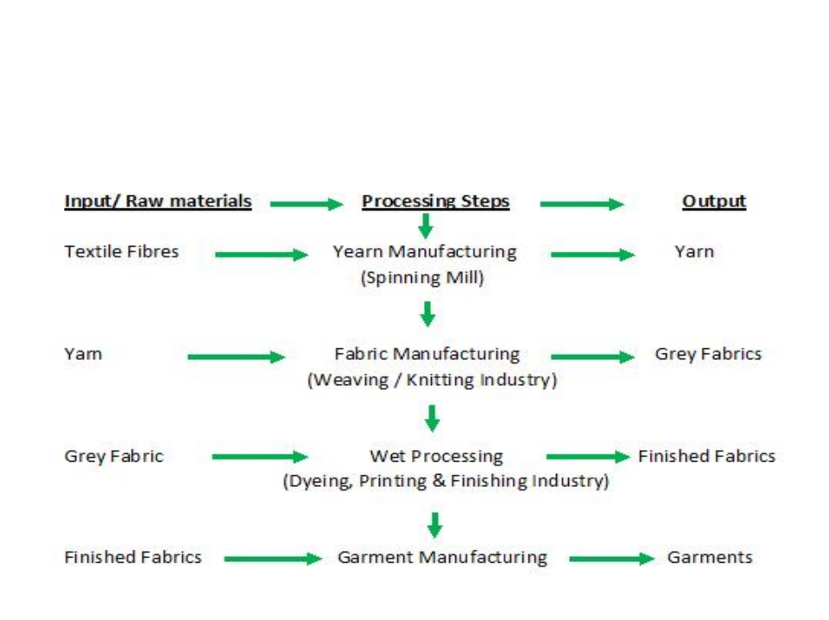
Textile production flow diagram

Slide 16
Water consumption in textile
industries
Fabric | Water consumption (kg/kg)
Cotton | 250-350
Wool | 200-300
Nylon | 125-150
Rayon | 125-150
Polyester | 100-200
Acrylic | 100-200

Slide 17
Process | Water consumption (%)
Bleaching, finishing | 38
Dyeing | 16
Printing | 8
Boiler house | 14
Humidification (Spinning) | 6
Humidification (weaving) | 9
Sanitary, Domestic | 9

Slide 18
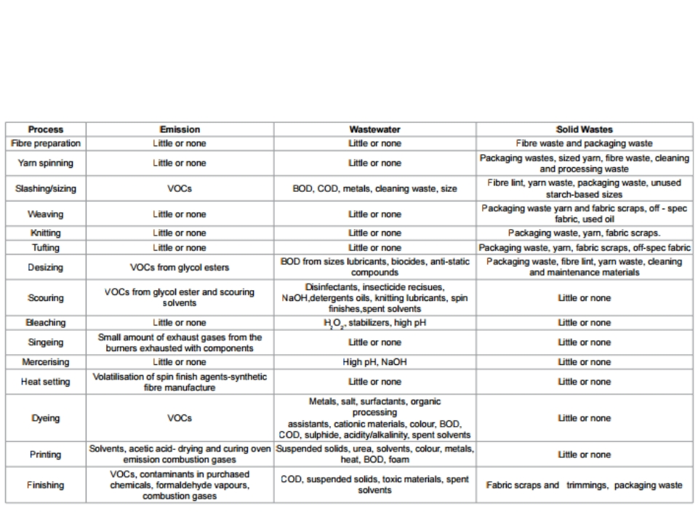
Emission and waste generation from
textile industry

Slide 19
Effluent characteristics from typical textile industry
Process | Composition | Nature
Sizing | Starch, waxes, carboxymethyl cellulose, polyvinyl alcohol. | High in BOD & COD
Desizing | Starch, waxes, carboxymethyl cellulose, polyvinyl alcohol. | High in BOD, COD, suspended solids, dissolved solids.
Scouring | Caustic soda, waxes, grease, soda ash, sodium silicate, fibres, sulfactants, sodium phosphate. | Dark colored, High pH, COD, dissolved solids.
Bleaching | Hypochlorite,Caustic soda, sodium silicate, hydrogen peroxide, sulfactants, sodium phosphate. | Alkaline suspended solids.
Mercerizing | Caustic soda. | High pH, low COD, high dissolved solids.
Dyeing | Various dyes, mordants, reducing agents, acetiv acid soap | Strongly colored, High COD, dissolved solids, low SS
Printing | Pastes, starch, gums, oil, mordants, acids, soaps. | Highly-colored, High COD, oily appearance, SS
finishing | Inorganic salts. | Slightly Alkaline, low BOD.

Slide 20
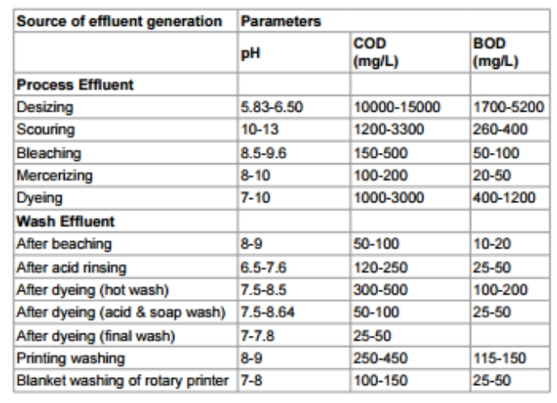
Waste water characteristics:
Process-wise

Slide 21
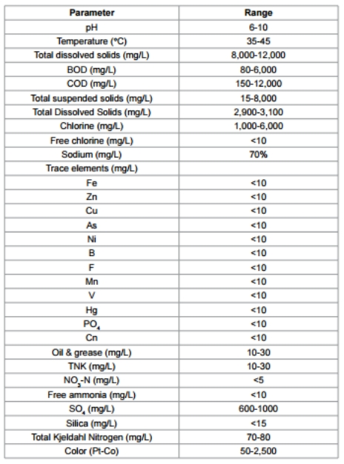
Important Characteristics of Waste water from Textile Industry

Slide 22
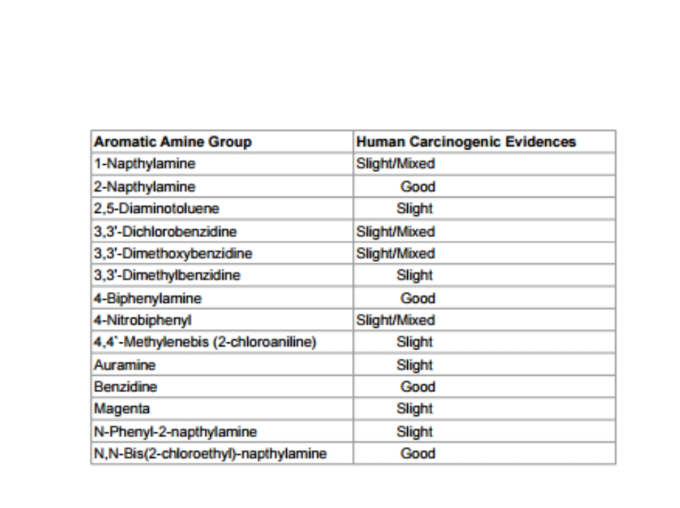
Human carcinogenic compund

Slide 23
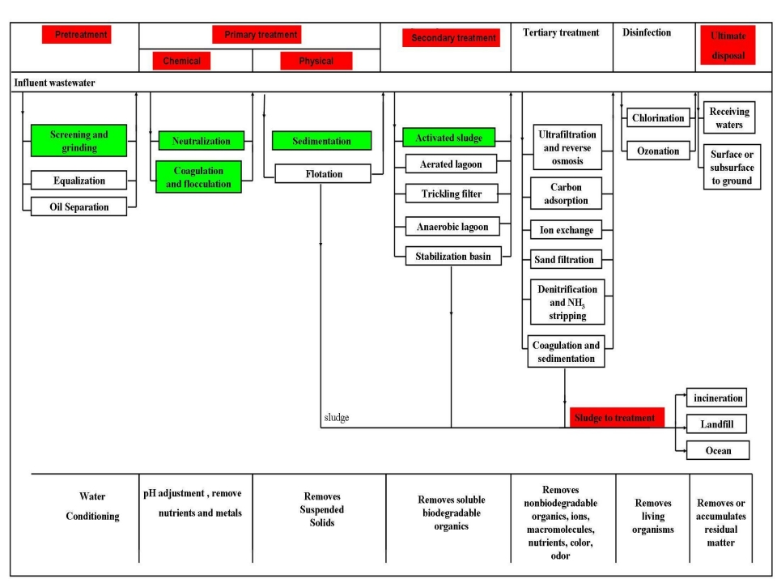
Possible Choice For
Wastewater Treatment
And Their Sequence.

Slide 24
ETP Plant Operation
1. Screen chamber:
Remove relatively large solids to avoid abrasion of mechanical equipments and clogging of hydraulic system.
2. Collection tank:
The collection tank collects the effluent water from the screening chamber, stores and then pumps it to the equalization tank.
3. Equalization tank:
➢ The effluents do not have similar concentrations at all the time; the pH will vary time to time.
➢ Effluents are stored from 8 to 12 hours in the equalization tank resulting in a homogenous mixing of effluents and helping in neutralization.
➢ It eliminates shock loading on the subsequent treatment system.
➢ Continuous mixing also eliminates settling of solids within the equalization tank. ➢ Reduces SS, TSS.
•

Slide 25
ETP Plant Operation
4. Flash mixer:
Coagulants were added to the effluents:
1. Lime: (800-1000 ppm) To correct the pH upto 8-9
2. Alum: (200-300 ppm) To remove colour
3. Poly electrolyte: (0.2 ppm) To settle the suspended matters & reduce SS, TSS. The addition of the above chemicals by efficient rapid mixing facilitates
homogeneous combination of flocculates to produce microflocs.
5. Clarriflocculator:
In the clarriflocculator the water is circulated continuously by the stirrer.
➢ Overflowed water is taken out to the aeration tank.
➢ The solid particles are settled down , and collected separately and dried; this reduces SS, TSS.
➢ Flocculation provides slow mixing that leads to the formation of macro flocs , which then settles out in the clarifier zone.
➢ The settled solids i.e. primary sludge are pumped into sludge drying beds.

Slide 26
ETP Plant Operation
6. Aeration tank:
➢ The water is passed like a thin film over the different arrangements like staircase shape.
➢ Dosing of Urea and DAP is done.
➢ Water gets direct contact with the air to dissolve the oxygen into water. ➢ BOD & COD values of water is reduced up to 90%.
7. Clarifier:
➢
The clarifier collects the biological sludge.
➢
The overflowed water is called as treated effluent and disposed out.
➢
The outlet water quality is checked to be within the accepted limit as delineated in the norms of the Bureau of Indian standards.
➢
Through pipelines, the treated water is disposed into the environment river water, barren land, etc.

Slide 27
ETP Plant Operation
8. Sludge thickener:
➢ The inlet water consists of 60% water + 40% solids. ➢ The effluent is passed through the centrifuge.
➢ Due to centrifugal action, the solids and liquids are separated.
➢ The sludge thickener reduces the water content in the effluent to 40% water + 60% solids.
➢ The effluent is then reprocessed and the sludge collected at the bottom.
9. Drying beds:
Primary and secondary sludge is dried on the drying beds.

Slide 28
FLOW CHART OF ETP
Influent
Screening
Equalization(Lime + Alum) pH = 8.5
SS, TSS removal
Disperse unit
Biological Treatment & Aeration
{Dosing = (Urea + DAP) for O 2} BOD removal ~ 90%
COD removal ~ 90%
RECYCLE
TANK
Sedimentation tank
{pH = 7.5}
Effluent
Fish pond
Sludge thickening unit
60% water +
40% solids
Effluent discharge
Sludge
40% water + 60% solids
Sludge discharge

Slide 29
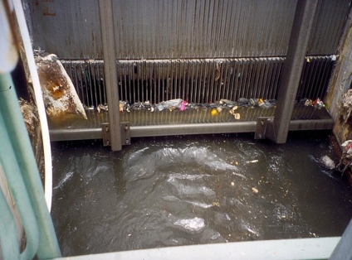
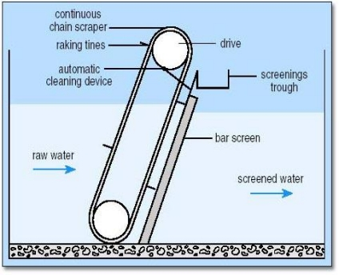
SCREENING
➢ Screening is the filtration process for the separation of coarse particles from influent.
➢ Stainless steel net with varying pore size can be utilized.
➢Screens are cleaned regularly to avoid clogging.

Slide 30
EQUALIZATION TANK
➢Equalization makes the waste water homogenous.
➢Retention time depends upon the capacity of treatment plant. (Generally 8-16 hours)
Spray of water coming
from dyeing unit
EQUALIZATION TANK
Cool
Influent from
&
screening
Homogenous
influent to
pHcorrection
Tank
Air for diffusion

Slide 31
PH CORRECTION
➢In this tank pH of the influent is corrected to meet the standard.
➢Acid or alkali is added to the effluent to increase or decrease the pH.
Acid or alkali
pHcorrection
Influent from
equalization
tank Influent of desired
to pH disperse unit

Slide 32
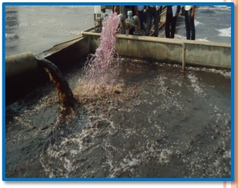
DISPERSE UNIT
Disperse tank mixes the sludge coming from recycle tank with waste water for to proper aeration.
Sludge from
recycle tank
DISPERSE UNIT
( MIXING OF SLUDGE & WASTE)
Influent from pH
correction tank
Mixed
influent &
sludge to
aeration

Slide 33
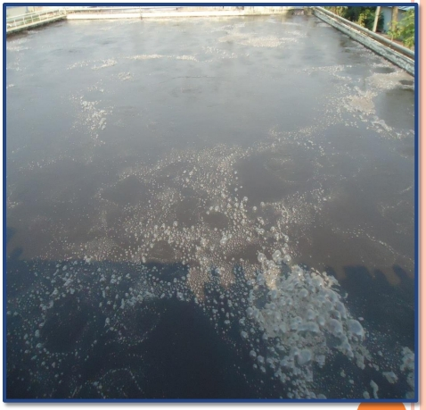
AERATION
➢ Function of aeration is oxidation by blowing air.
➢ Aerobic bacteria is used to stabilize and remove organic
material presents in waste.

Slide 34
SCHEMTIC DIAGRAM OF AERATION
Aerobic bacteria
AERATION TANK
Mixture of
Discharge to
waste water
sedimentation
& sludge
tank
O
2
AIR
REACTION IN AERATION TANK:
ORGANIC MATTER + O2
BACTERIA
CO2+ HO2 + HEAT
NUTRIENT

Slide 35
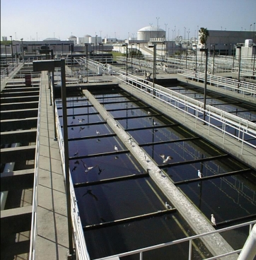
SEDIMENTATION TANK
➢ In this tank sludge is settled down.
➢ Effluent is discharged from plant through a fish pond.
➢ Sludge is passed to the sludge thickening unit.

Slide 36
SCHEMTIC DIAGRAM OF SEDIMENTATION TANK Waste water from
sedimentation pack
SEDIMENTATION
TANK
Sludge to
thickening unit
Effluent
Effluent
Discharge
Fish pond
Fish Pond is used to see survival of fishes to ascertain fitness of water for disposal

Slide 37
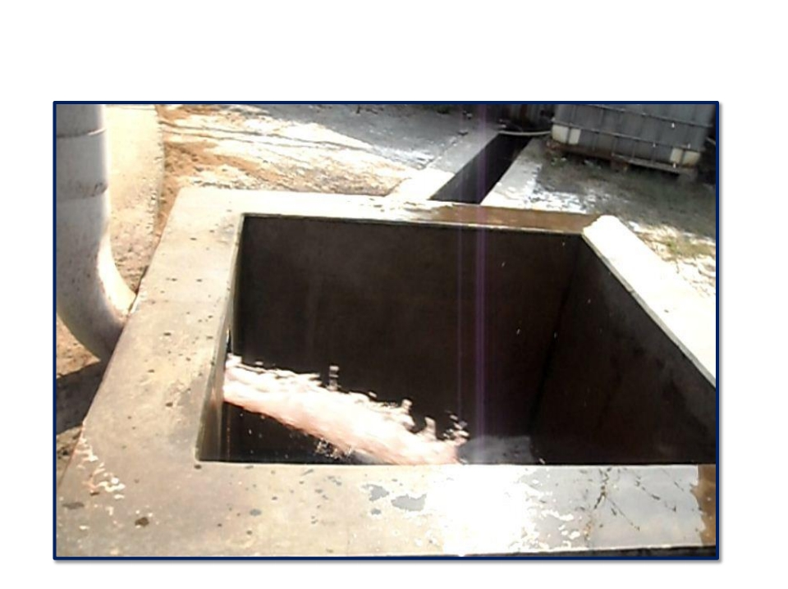
EFFLUENT DISCHARGE

Slide 38
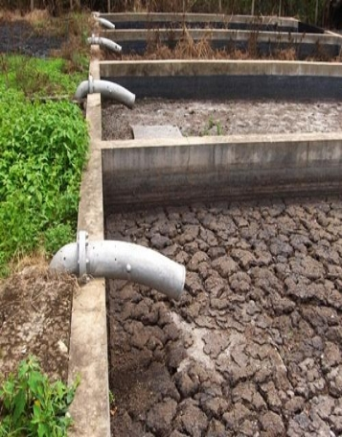
SLUDGE THICKENING UNIT
➢Here sludge is dried and discharged.
➢Partial amount of sludge is returned back to the aeration tank from thickening unit
through recycle tank called return sludge tank and disperse tank.

Slide 39
SCHEMTIC DIAGRAM OF SLUDGE
THICKENING UNIT
Sludge from
Sludge discharge
sedimentation unit
SLUDGFE
THICKENING UNIT
Sludge to recycle
tank

Slide 40
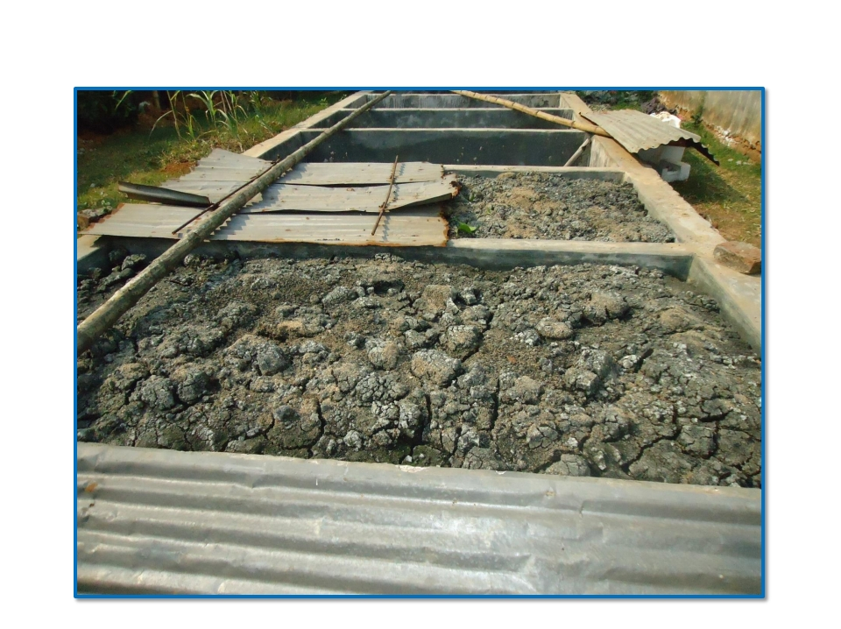
DRIED SLUDGE

Slide 41
RETURN SLUDGE TANK
Function of return tank or recycle tank is to mix water with sludge
This mixture is then passed to aeration tank through disperse tank.

Slide 42
ADVANTAGE OF RECYCLE SLUDGE TO AERATION TANK ➢ Sludge again oxidized to minimize the pollution from sludge.
➢ Alive bacteria of sludge is again used in aeration to utilize this bacteria.
Sludge from
SLUDGE
RECYCLE TANK
thickening
Sludge to aeration
unit
tank through
disperse unit
Mixing of sludge &
water

Slide 43
PERMISSIBLE STANDARDS IN INDIA
S.No. | Parameter | Permissible limits (disposal to inland surface water)
1 | pH | 5.5 to 9.0
2 | TSS | <100 mg/l
3 | Oil & Grease | <10 mg/l
4 | BOD | <30 mg/l
5 | COD | <250 mg/l

Slide 44
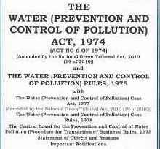
SALIENT PROVISIONS OF WATER ACT (1974)
After the Stockholm conference on Human Environment on June, 1972, it was considered appropriate to have uniform law all over country for broad Environment problems.
The Water (Prevention & Control of Pollution) Act, 1974 is the first enactment by the Parliament in this direction.
Water Act is enacted with the aim of prevention and control of Water Pollution in India.

Slide 45
OBJECT & SCOPE
An Act to provide for the levy and collection of access on water consumed by persons carrying on certain industries and by local authorities, with a view to augment the resources of the Central Board and the State Boards for the prevention and control of water pollution constituted under the Water (Prevention and Control of Pollution) Act, 1974.
This Act aims at establishment of Central and State Pollution Control Board at the central level and also at state level for each state and giving powers to the members so as to enable them to carry out the purposes of the
Its having two boards for controlling the whole law
1. Central Board 2. State Board

Slide 46
POWERS AND FUNCTIONS OF BOARDS
Functions & Power of Central Board
Functions & Power of State Board
The main function of the Central Board shall be to promote cleanliness of streams and wells in different areas of the States.
Advice the Central Government on any matter concerning the prevention and control of water pollution.
lay down standards for Stream & well.
Every State Board shall be bound by such directions in writing as the Central Board or the State Govt. may give to it.
Where the Central Government is of the opinion that any State Board has defaulted in complying with any directions given by the Central Board under sub-section.
Control the pollution is state

Slide 47
PREVENTION AND CONTROL OF WATER POLLUTION
Power State Government to restrict the application of the Act to certain areas (section 19)
Power to obtain information (section 20)
Power to take samples of effluents and procedures to be followed in connection there with (section 21)
Reports of the results of analysis on samples taken under section 21 (section 22)
Power of entry and inspection (section 23)
Prohibition on use of stream or well for disposal of polluting matter (section 24)
Restrictions on new outlets and new discharges (section 25)

Slide 48
PENALTIES AND PROCEDUR

Slide 49
MISCELLANEOUS
Reports of analysts (sec. 54) - Any document purporting to be report signed by a Government analyst or, as the case may be, a Board analyst may be used as evidence of the facts stated therein in any proceeding under this Act.
Local authorities to assist (sec. 55) - All local authorities shall render such help and assistance and furnish such information to the Board as it may require for the discharge of its functions, and shall make available to the Board for inspection and examination such records, maps, plans and other documents as may be necessary for the discharge of its functions.

Slide 50
MISCELLANEOUS
Compulsory acquisition of land for the State Board (sec. 56)
Returns and reports (sec. 57)
Bar of jurisdiction (sec. 58)
Protection of action taken in good faith (sec. 59)
Overriding effect (sec. 60)

Slide 51
