Slide 1
Automation in Combing Section
In general, automation in combing can be subdivided into:
transport automation and Machine automation.
Transport automation in combing indicates mainly the shifting of laps from the lap former to the comber.
Two automation systems are available in this case:
semi-automatic transport and
Fully automatic transport.
In semi automatic transport trolleys are automatically loaded with laps at a filling station (a) in front of the lap former. Then the trolley (b) is manually transferred to the combers, where unloading is performed semi-automatically.
In fully automatic system overhead transport device is used (Fig. 2) to carry the laps in groups of 8 at a time to the combers.

Slide 2
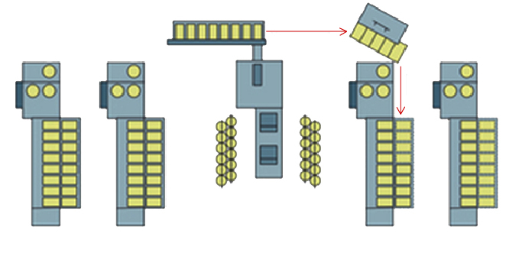
Fig 1: Transport scheme with semi-automated lap trolleys (4 combers are shown (2 left and two right) with the lap former in-between)

Slide 3
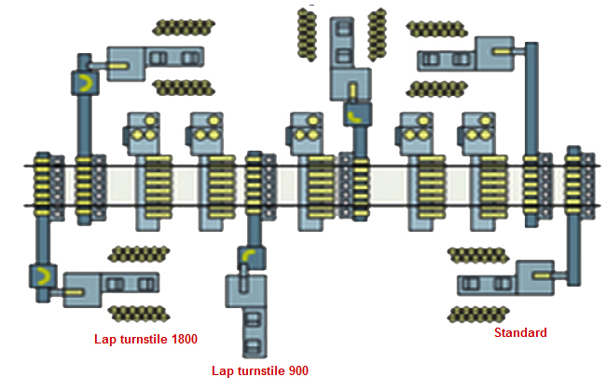
Fig. 2 – Fully automatic lap transport system, showing the lap turnstile required to present the lap end in the correct position for the combers

Slide 4
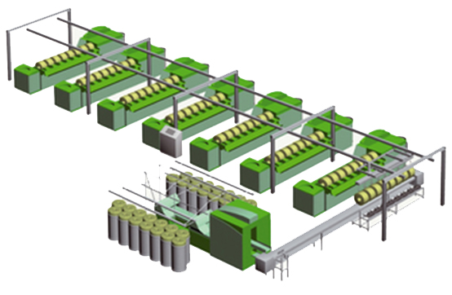
An additional installation is required between lap former and combers called lap turnstile as shown in Fig.3 which is used to load the laps into the overhead carriers in the right direction (i.e. prepared for automatic piecing on the comber). The whole loading, unloading and transportation operation is performed without intervention by an operator.
Fig. 3 – The overhead transport system

Slide 5
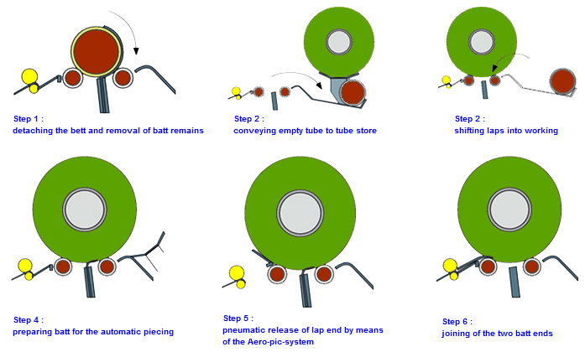
Machine Automation (Comber)
It includes Automation of lap changing and batt piecing
Fig. 4 – Automatic lap changing and batt piecing

